Slide 1
Games Bootcamp Sound & VFX

Slide 2
Recap
Game Managers

Slide 3
Table of contents
01
Sound In Games
02
Particle Systems
03
Scripting SFX & VFX
applications
Visual effects
How to script sounds & vfx

Slide 4
01
Sound
Music, Ambience & Sound Effects

Slide 5
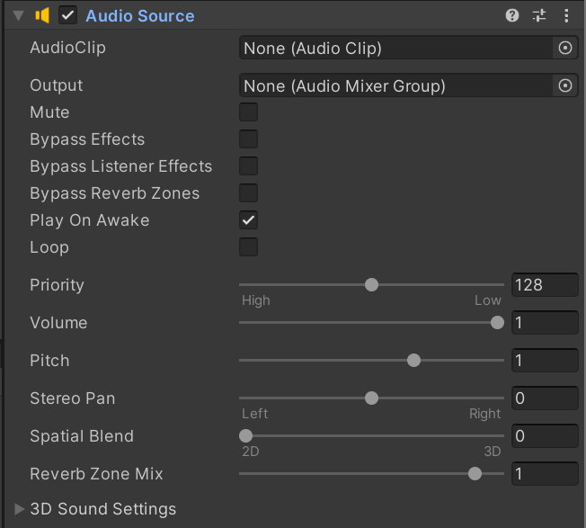
Unity Sound System (1)
Unity’s sound system provides some components to implement basic 3D sound.
The AudioListener is the ‘ears’ of the player. There is usually only one in the scene and is attached to the main camera.
The AudioSource can be attached to objects in your scene
It holds a reference to an AudioClip and can be configured in different ways

Slide 6

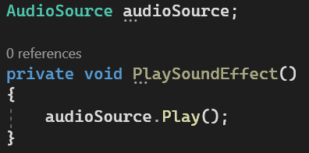
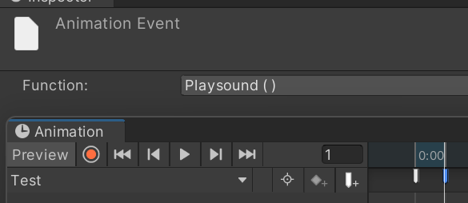
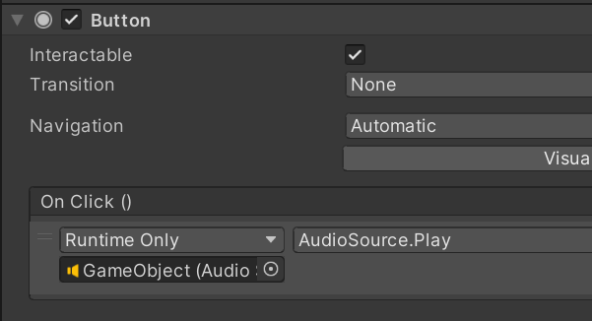
Unity Sound System (2)
Sounds can be triggered in a variety of ways.
Audio Source:
Scripts:
Animation:
Button/Events:

Slide 7


Unity Sound System (3)
Audio Source Functions:
Plays the currently assigned clip, will loop if the option is ticked
Plays a new clip without interrupting assigned clip.
Plays assigned clip after a specified delay.
Stops the clip from playing.

Slide 8
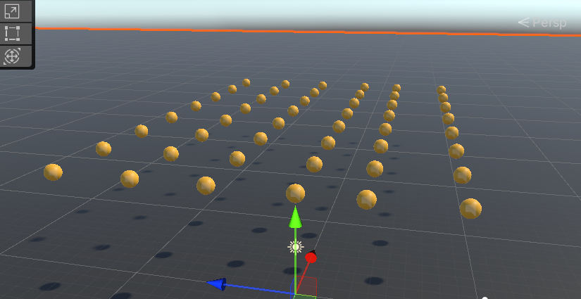
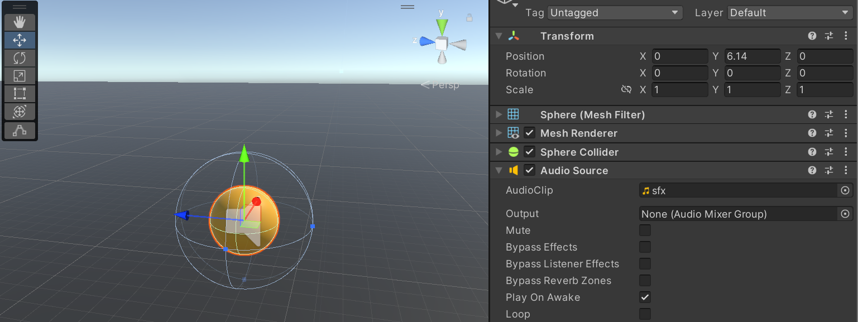
Unity Sound System (4)
Sound effects are reused throughout your game…
Assigning references manually makes it difficult to change things down the line
This is where Prefabs and Managers shine.

Slide 9
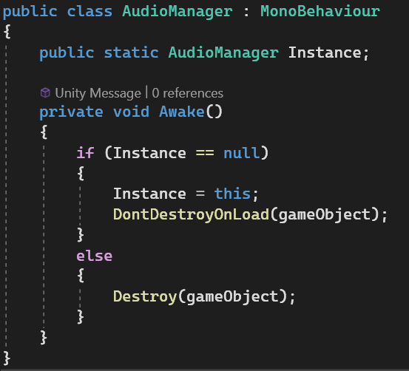

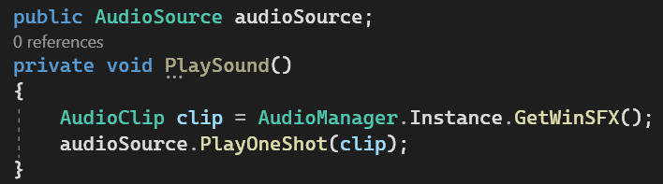
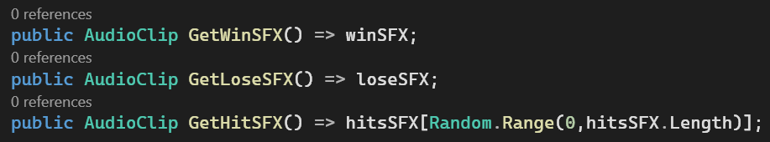
Unity Sound System (4)
First we create a singleton AudioManager.
Next we store any sound effects we want
We can then create public functions to return the clip
We can play the right sound from our ball script.

Slide 10
02
Particle Effects

Slide 11
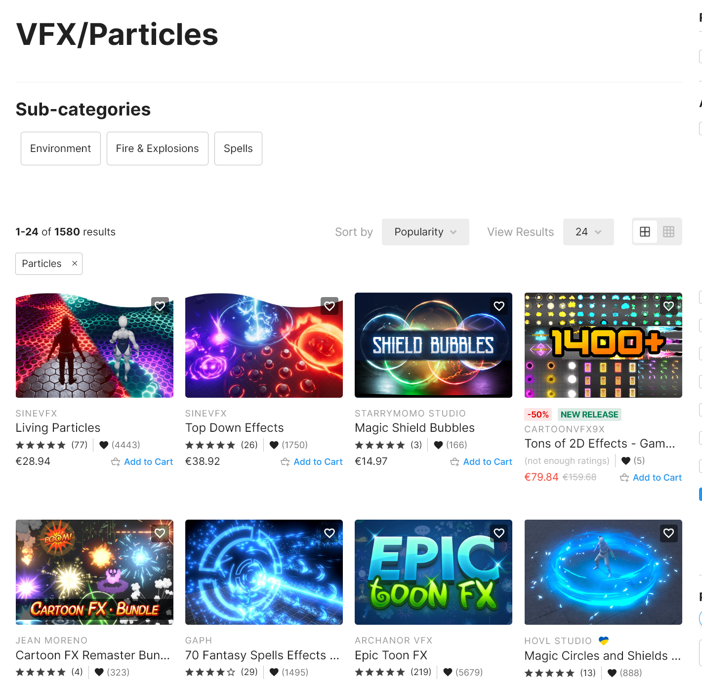
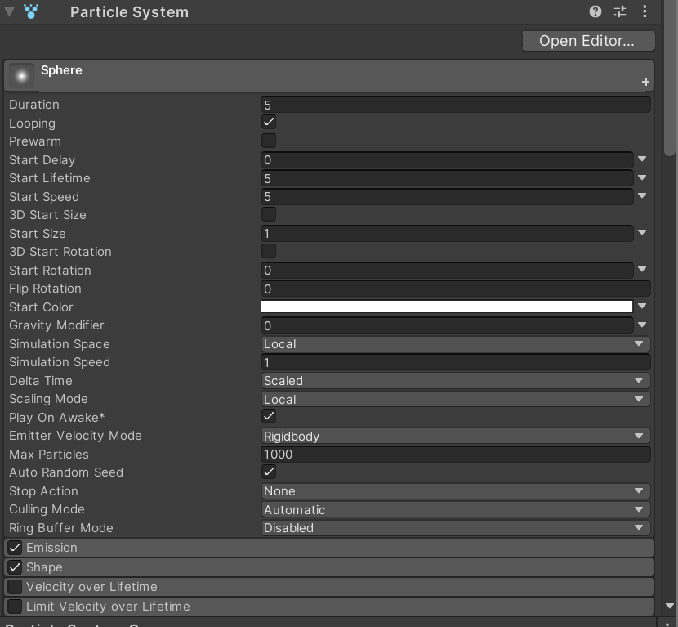
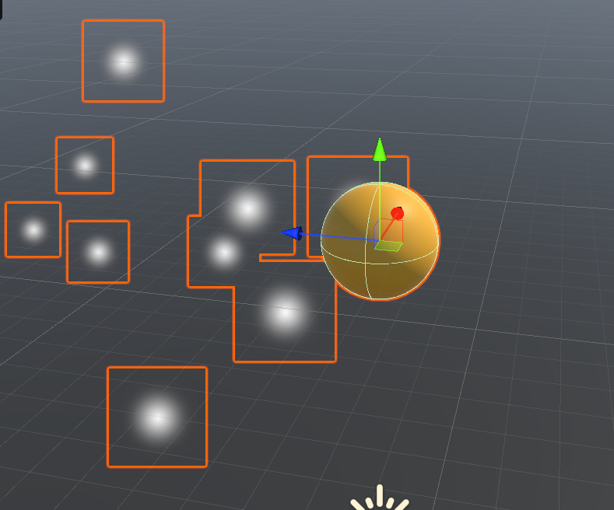
Unity Particle System (1)
The Particle System is a powerful tool for creating visual effects in unity. Advanced effects are made by artists with custom assets but you can go far with just the adjustments alone.

Slide 12
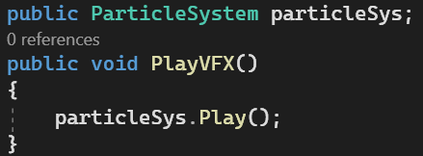
Unity Particle System (2)
Particle systems can be triggered in the same way as audio.

Slide 13
Unity Particle System (3)
Particle Systems can be very performance intensive both for the CPU and GPU
Each particle in a system requires calculations for its position, movement, rotation, color, size, etc. The more particles there are, the more calculations are required per frame.
Overdraw occurs when multiple particles overlap on the screen, causing the GPU to render multiple layers for a single pixel. This is especially taxing when using semi-transparent particles.
If particles are set to detect and react to collisions, especially with complex geometry, this can be computationally expensive.
If particles use complex shaders for rendering, this can increase the GPU's workload.
Particles that emit or interact with lighting, especially dynamic lighting, can increase computational costs.

Slide 14
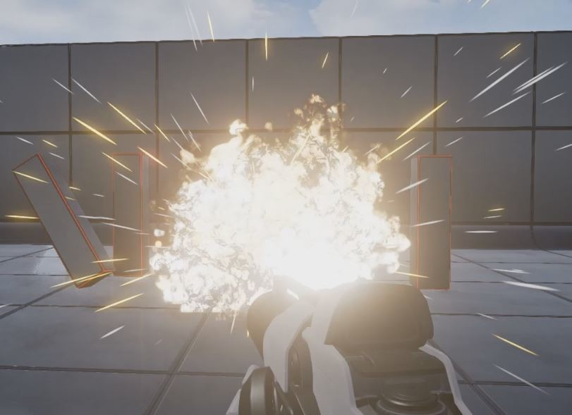
Grenade Example
Notes:
Introduce prefab use.

Slide 15
Thanks!

